Slide 1


Slide 2
Progression of Formulate
02/2023
04/2023
09/2022
-Revision 1 product
created
-Optimized product
-Achieved automation
in testing procedure
-Project vision created
-Identified a need in extra-curricular, engineering teams
-Revision 0 product
created
-Fully functional product

Slide 3
Project Vision
Target Problem
-Create a standardized format for testing
Ideal User
-McMaster Formula Electric
-Any members completing tests with sensors
Expected Hardware
-Device capable of supporting sensor data and field tests
Expected Software
-User interface
-Platform to visualize data

Slide 4



Revision 0 Implementation
Hardware
-Integrate a Printed Circuit
Board (PCB)
-3D print chassis to enclose
the PCB
-Connection mechanisms
User Interface + Database
-Wireless connection to device
-Comprehensive UI
-Authentication
-Adding notes to tests
Data Dashboard
-Establish connection with database
-Visualized data for user
-Access for previous tests

Slide 5
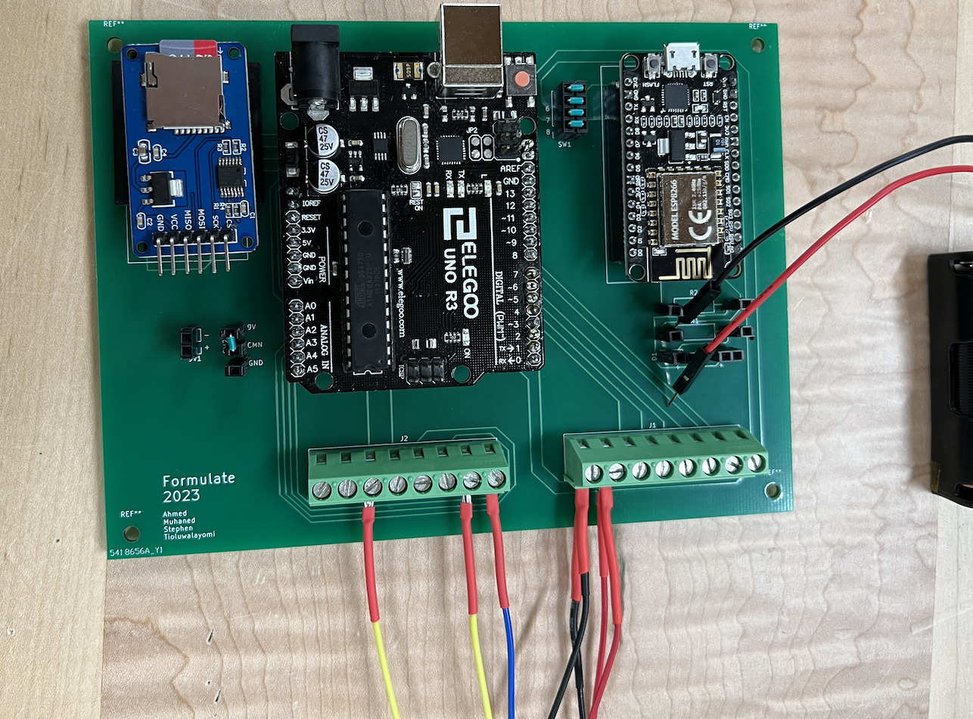
Electrical Hardware Design
High Connection Reliability
PCB copper connections between components
Sensor conductor connections
Screw down terminal blocks minimize vibration connection failure
Wireless connectivity
2 hours of continuous, wireless test time

Slide 6
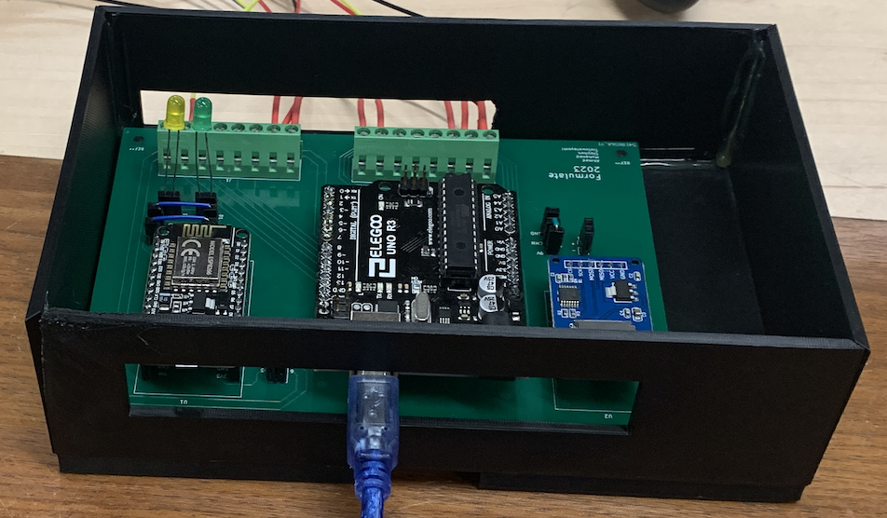
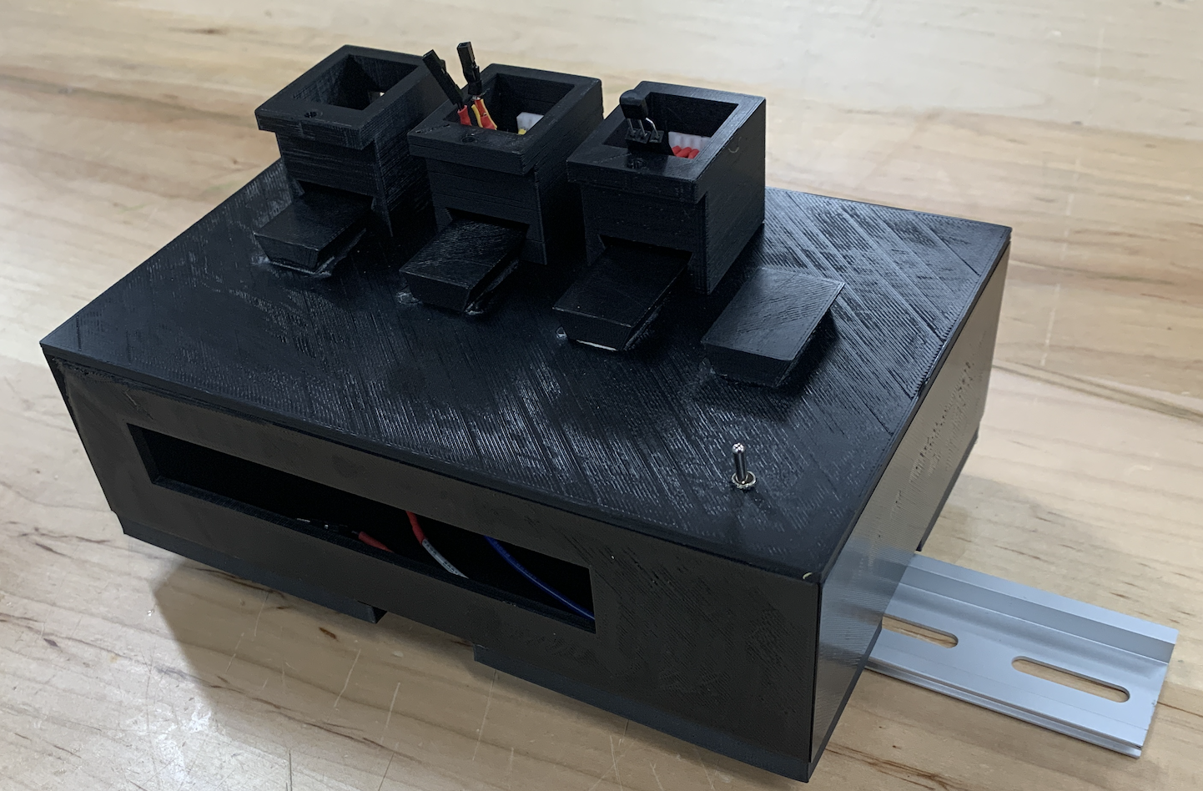
Mechanical Hardware Design
Mounting Feature
Device connected to DIN Rail
DIN Rail fastens to any flat plane using M6 bolts
Sensor Mounting Feature
Easy fit for sensor housing onto device top cover
Simplified JST connectors for quick release

Slide 7
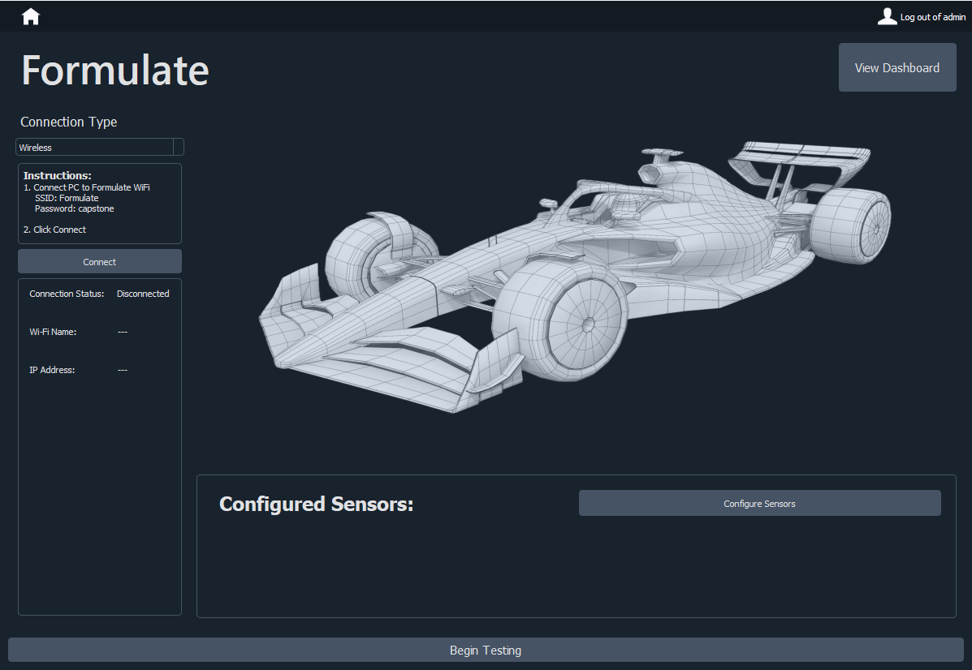
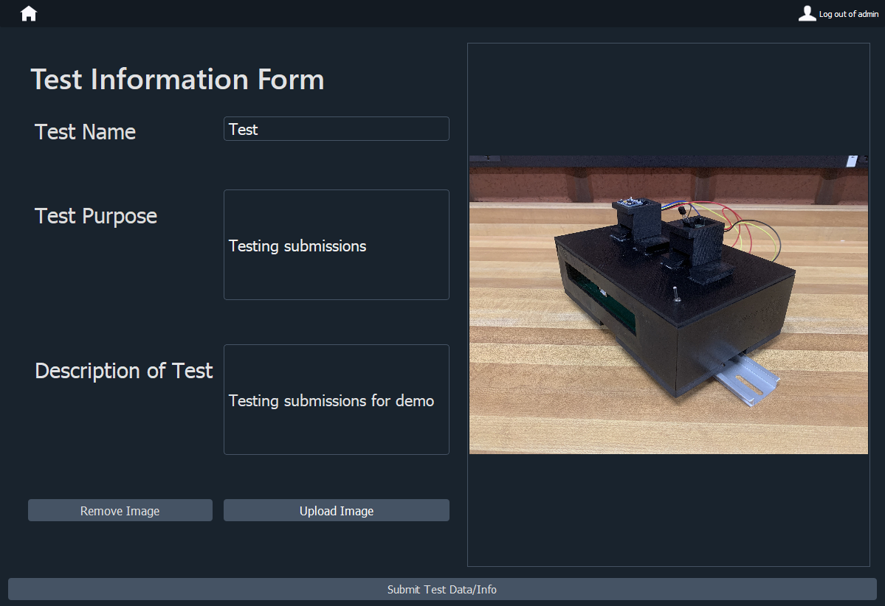
Software Design: User Interface
Comprehensive UI
Authentication
Connecting to device wirelessly
Adding test information

Slide 8
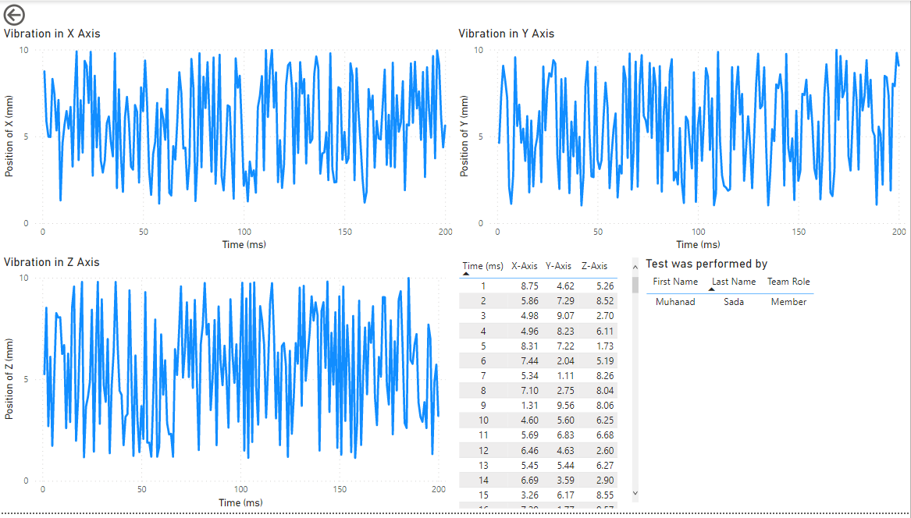
Software Design: Data Dashboard
Established Connection
We initially established to our database through Power Bi, allowing us to access test Data
Visualized Data
We created graphs for user to see test data values as they are recorded over time
Access to previous tests
Allowed for tracking and viewing of previous tests results.

Slide 9
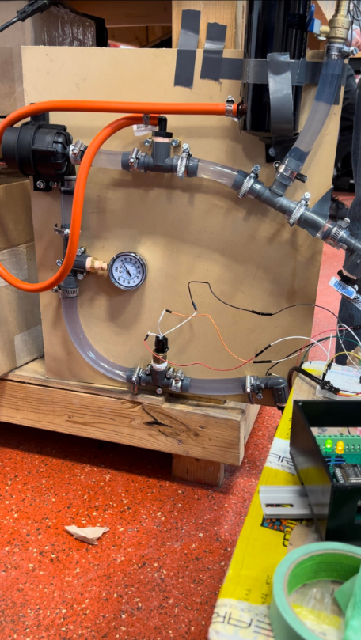
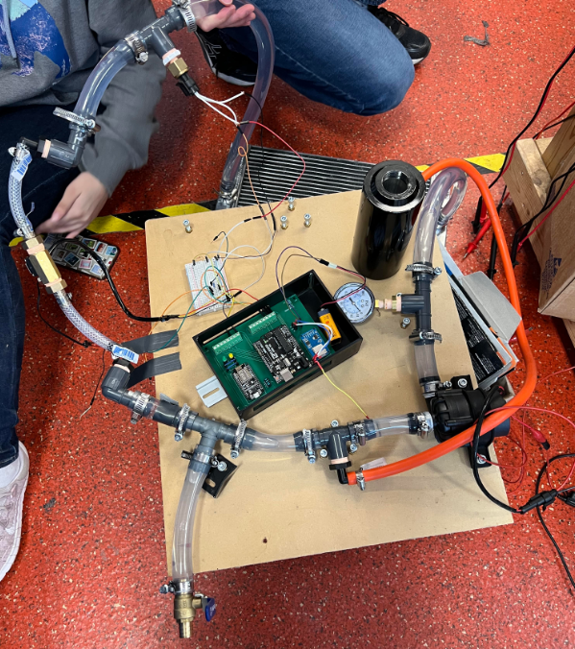
Testing: Formula Electric Cooling System
Key takeaways
Simplicity in code setup improves useability greatly
Portability is key

Slide 10
Revision 1 Goals
Hardware
-Minimize PCB size and chassis size
-Optimize lid latching mechanism
User Interface + Database
-Automatic code generation for
configuring sensors
-Retrieving previous test data from
device
-Error handling
Data Dashboard
-Increased Usability
-Increased Accessibility
-User Access Control
-Customizable for User
-Incorporated Feedback

Slide 11
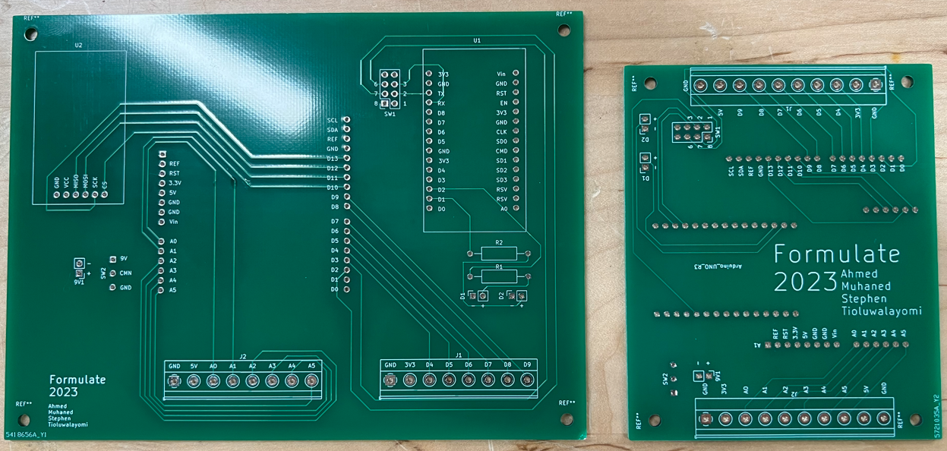
Electrical Hardware Design
Reduced form factor
PCB area reduction of 53.5%
Rev0 design: 151 x 112 [mm]
Rev1 design: 97 x 81 [mm]
Improved portability at no functional cost
All functionality maintained
5 analog and 5 digital inputs

Slide 12
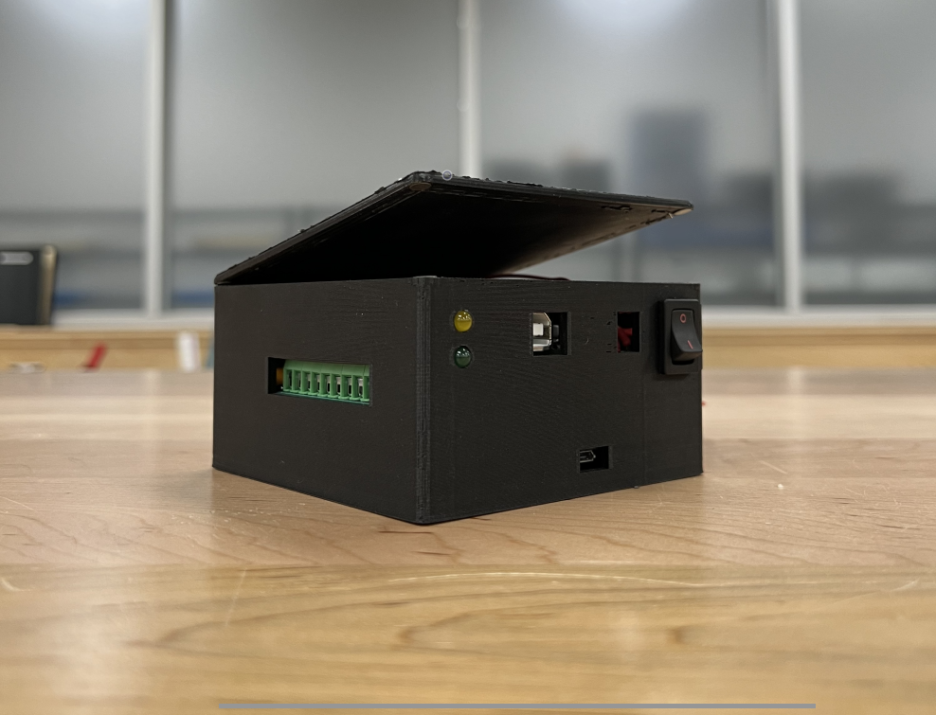
Mechanical Hardware Design
Improved portability
Chassis volume reduction of 53%
Rev0 chassis volume: 120 x 186 x 61 [mm]
Rev1 chassis volume: 106 x 104 x 58 [mm]
Quick release top cover
Magnetic connection

Slide 13
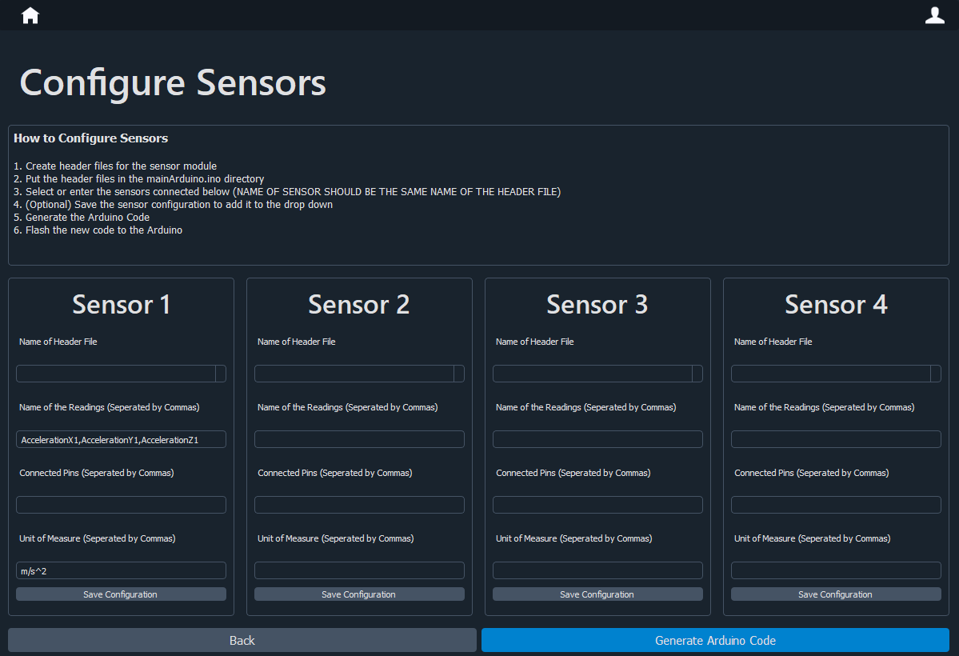
Software Design: User Interface
Software experience optimization
Code generation for configuring sensors
Retrieving previous test data
Error handling

Slide 14
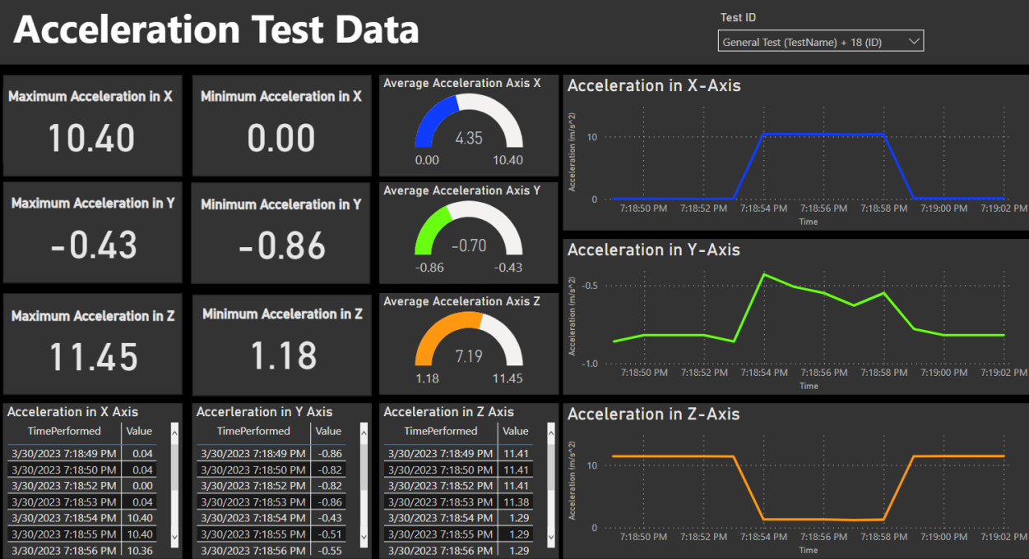
Software Design: Data Dashboard
Improved Usability
Improved the overall usability of the dashboard by changing the layout, design, and labeling.
Customizable Dashboard
The user will be able to modify and added new features to the dashboard if required

Slide 15
Formulate Project Features
Hardware
-20 m of wireless range
-2 hours of continuous testing
-Failsafe test storage
User Interface + Database
-Code that writes code for sensor configuration
-250 GB of database storage
Data Dashboard
-Test history Tracking
-Remote Access
-Data Export
-Customization

